Slide 1
MongoDB VS SQL
NoSQL (“non SQL” or “not only SQL”)

Slide 2
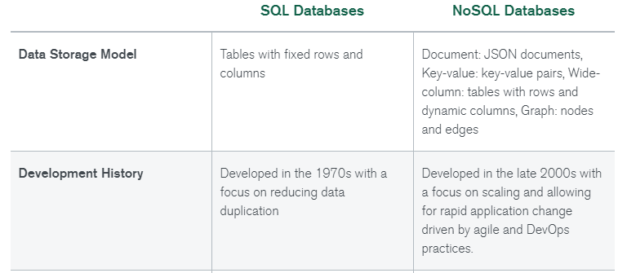
Differences between SQL and NoSQL

Slide 3
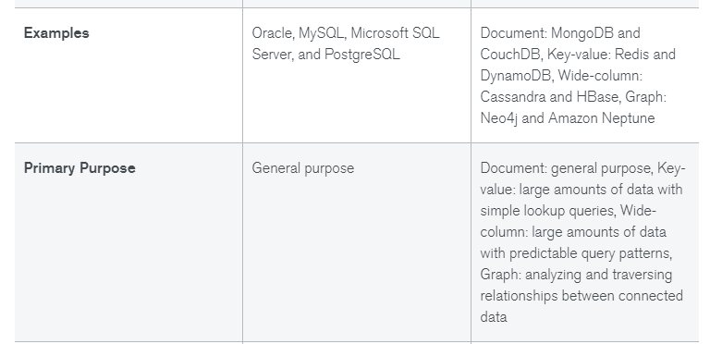
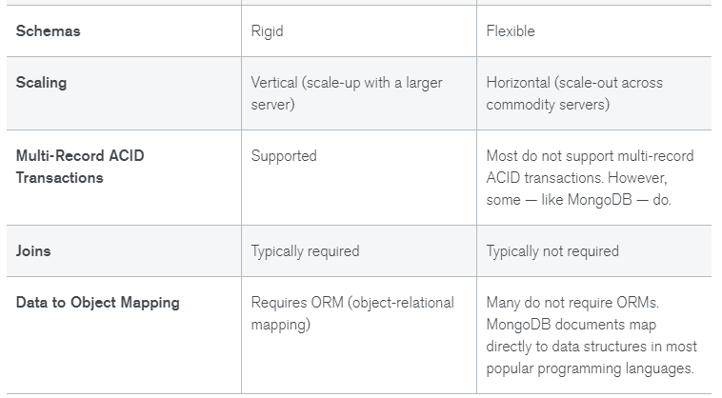

Slide 4
What are the benefits of NoSQL databases?
NoSQL databases offer many benefits over relational databases. NoSQL databases have flexible data models, scale horizontally, have incredibly fast queries, and are easy for developers to work with.
What are the drawbacks of NoSQL databases?
One of the most frequently cited drawbacks of NoSQL databases is that they don’t support ACID (atomicity, consistency, isolation, durability) transactions across multiple documents. With appropriate schema design, single-record atomicity is acceptable for lots of applications. However, there are still many applications that require ACID across multiple records.
What are the Advantages of SQL databases?
SQL has many advantages which makes it popular and highly demanded. It is a reliable and efficient language used for communicating with the database. Some advantages of SQL are as follows:
Faster Query Processing – Large amount of data is retrieved quickly and efficiently. Operations like Insertion, deletion, manipulation of data is also done in almost no time.
No Coding Skills – For data retrieval, large number of lines of code is not required. All basic keywords such as SELECT, INSERT INTO, UPDATE, etc are used and also the syntactical rules are not complex in SQL, which makes it a user-friendly language.
Standardized Language – Due to documentation and long establishment over years, it provides a uniform platform worldwide to all its users.
Portable – It can be used in programs in PCs, server, laptops independent of any platform (Operating System, etc). Also, it can be embedded with other applications as per need/requirement/use.

Slide 5
Disadvantages of SQL :
Although SQL has many advantages, still there are a few disadvantages. Various Disadvantages of SQL are as follows:
Complex Interface – SQL has a difficult interface that makes few users uncomfortable while dealing with the database.
Cost – Some versions are costly and hence, programmers cannot access it.
Partial Control – Due to hidden business rules, complete control is not given to the database.

